Slide 1
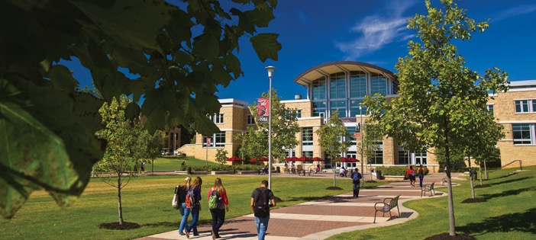

Center for Excellence in
Teaching and Learning (CETL)
An Overview of the CETL for New Faculty Orientation
August 16, 2023

Slide 2
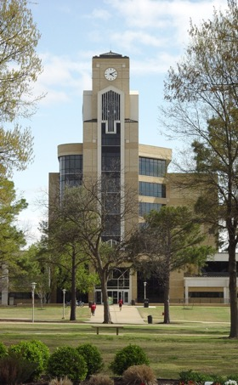
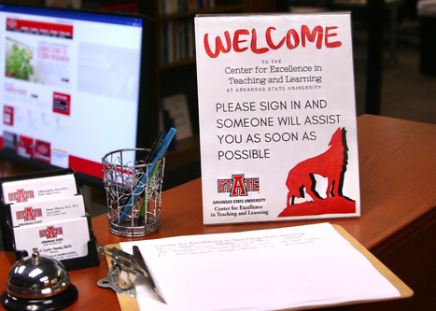
Welcome to the CETL!
Suite 301, Dean B. Ellis Library

Slide 3
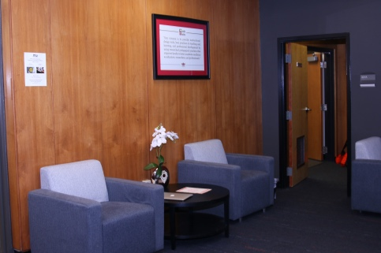
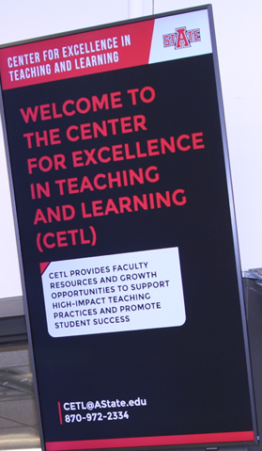
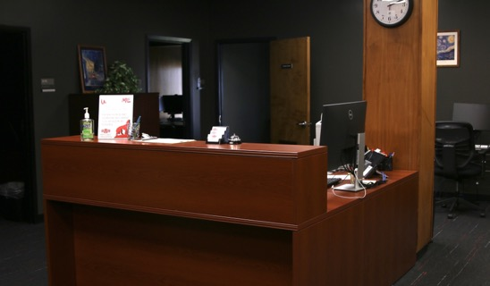

Slide 4

Our Work:
The CETL advances initiatives in teaching and learning and works to sustain a culture of teaching excellence, regardless of the mode of course delivery, supported by meaningful and ongoing professional development.

Slide 5

We provide:
Flexible goal- and needs-oriented programming and activities for early-, mid-, and later-career faculty
Support and resources for the use and creation of instructional tools and videos
Individual and group trouble-shooting and support for using instructional technology to enhance teaching and learning

Slide 6
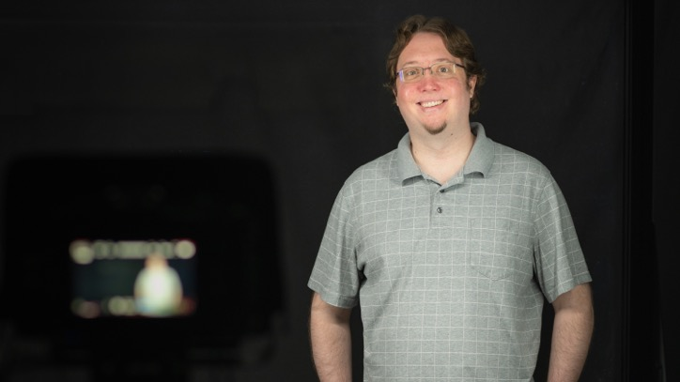
Meet the CETL Staff:
Dean Murry, Digital Services Coordinator

Slide 7
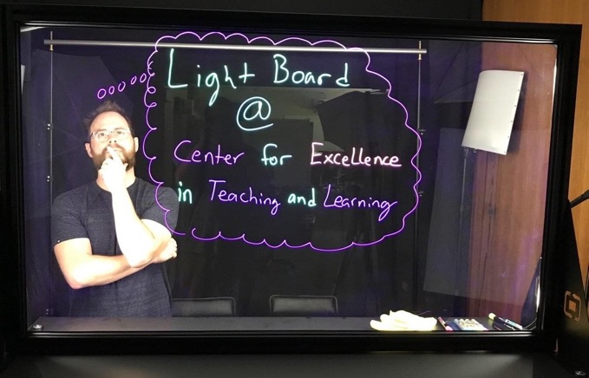
Meet the CETL Staff:
Chris Earnhart, Faculty Support Specialist

Slide 8
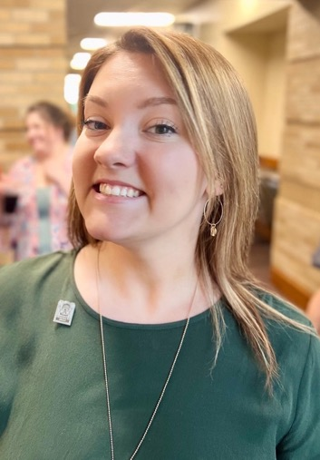
Meet the CETL Staff:
Kayle Long
Graduate Assistant
(and ray of sunshine!)

Slide 9
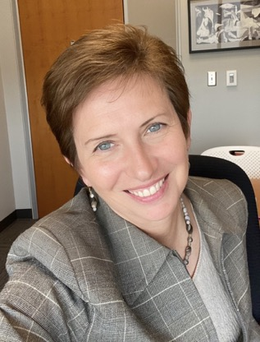
Meet the CETL Staff:
Dr. Ruth Owens,
CETL Director,
Associate Professor
of Spanish

Slide 10
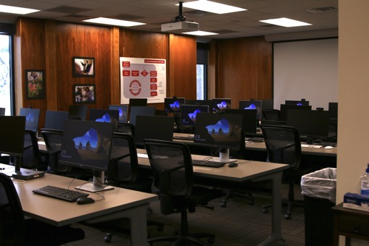
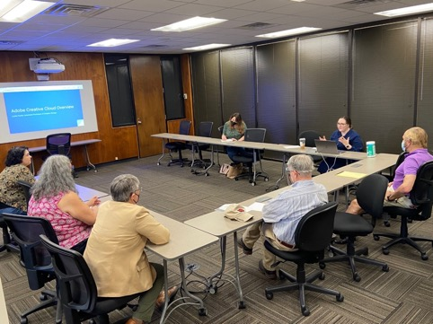
CETL Tour:
Master Classroom

Slide 11
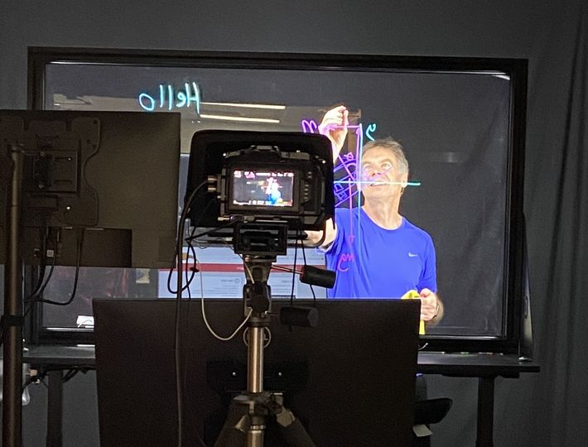
Video Recording Studio
With Lightboard
CETL Tour:

Slide 12
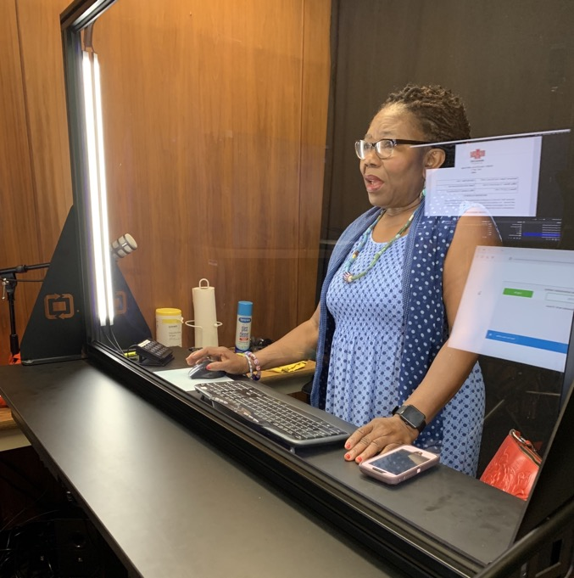

Slide 13
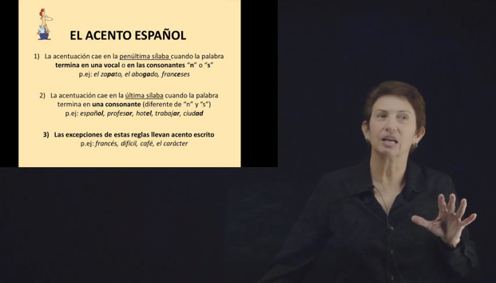
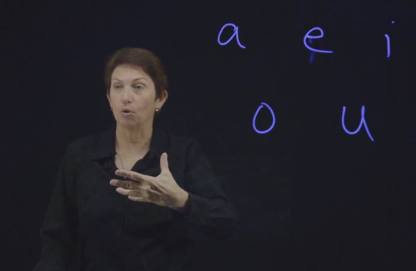

Slide 14
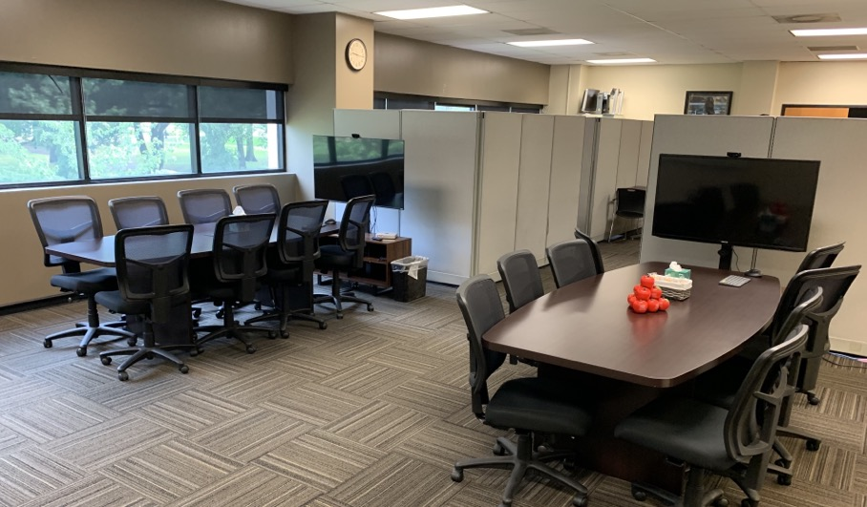
The Collaboratory
CETL Tour:

Slide 15


A-State / ACUE Partnership

Slide 16
Our partnership with ACUE offers:
online courses for faculty rooted in evidence-based teaching practices
courses delivered in facilitated cohort groups
the only nationally-recognized university faculty credential endorsed by the American Council on Education (ACE)
data showing that implementation of ACUE practices improves student engagement, increases persistence, and closes equity gaps

Slide 17
Watch for upcoming announcements regarding:
Faculty Learning Communities
Faculty Book Discussion Groups
Guest Speakers
Workshops (both pedagogy and technology)
Showcases of faculty work

Slide 18
And more …
Please visit and tell us what you need!
Center for Excellence in Teaching and Learning
(CETL)
CETL@AState.edu
Ruth Owens, Director
rsupko@AState.edu

Slide 19

Thank you for your
time and attention

